Slide 1
Lecture 2 – Introduction to Microbiota analysis
Corinne Benakis & Adam Sorbie
Institute for Stroke and Dementia Research
Munich, Germany
Gut Brain axis course 30.06.23

Slide 2
Outline
1.
Microbiome sample preparation
2.
Microbiome data processing
3.
Microbiome data analysis

Slide 3
Day 2 structure
Conducting a microbiome experiment
15 min break
Microbiome data analysis
15 min break
Quiz

Slide 4
Sample processing and collection steps
Experimental design/power analysis
Sample type, collection method & storage
DNA extraction
Library preparation & Sequencing/Sequencing method

Slide 5
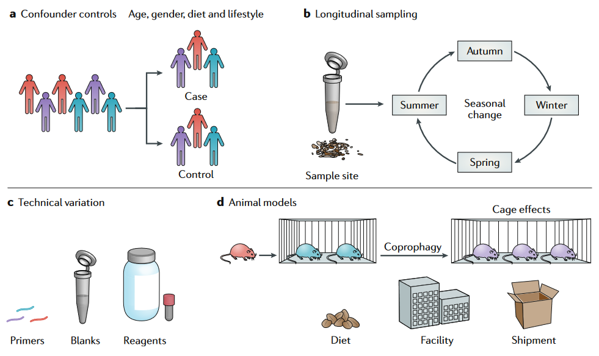
Experimental design
Type of study, cross-sectional or longitudinal?
Number of samples
Readout
Taxonomic and/or functional measurement
Metadata collection
Potential confounders

Slide 6
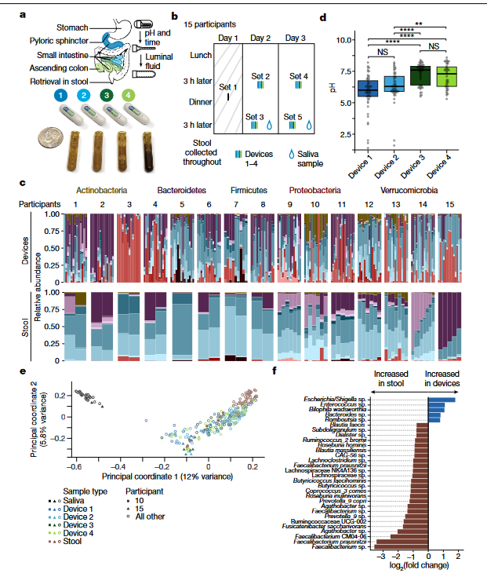
Sample type
Stool or other tissue?
Stool samples snapshot of entire GI
Does not reflect stomach or SI communities well
Chosen readout(s) dictates sample type
Certain sample types may have high ratio of host to microbial DNA/metabolites precluding certain measurements
Shalon et al 2023, Nature

Slide 7
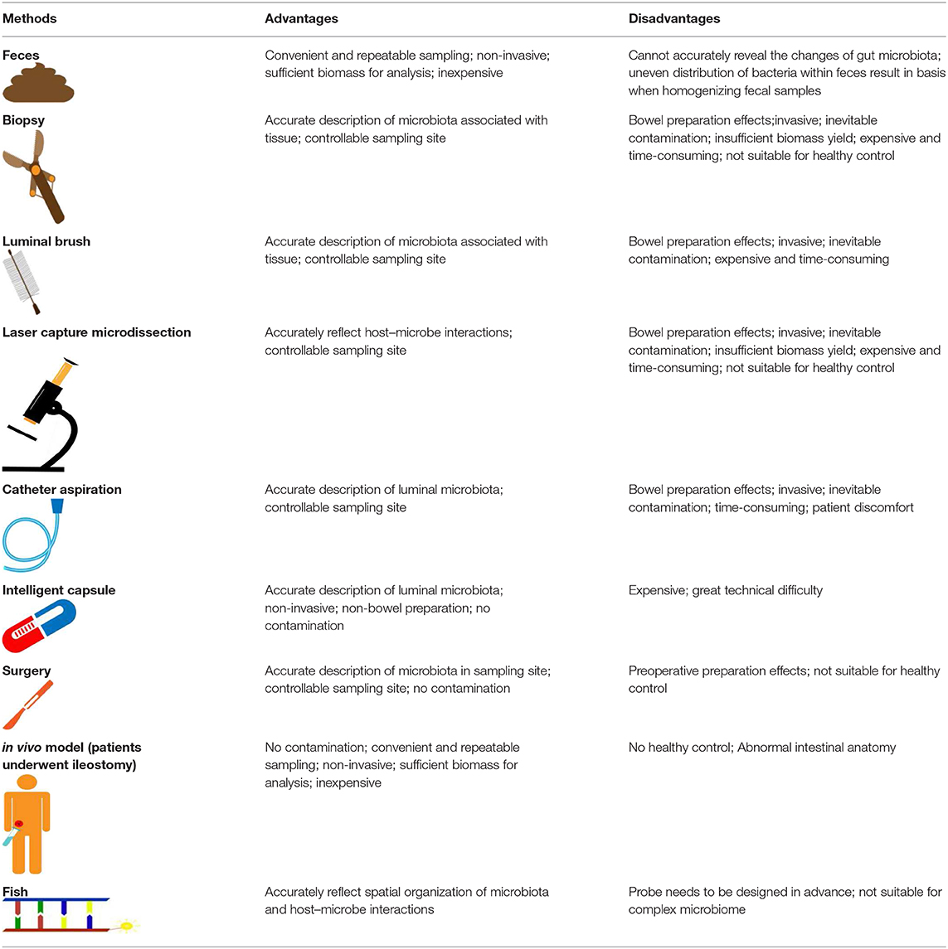
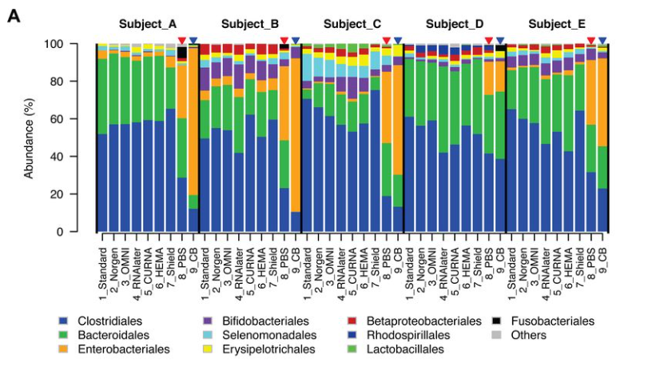
Sample collection & storage
For each sample type, several collection methods
E.g., for stool samples, fresh or faecal swab
Not all collection methods equal
Different methods not always directly comparable
Storage method also impacts microbial composition
Processing samples immediately or storage at -80°C recommended
Tang et al 2021, Front. Cell. Infect. Microbiol

Slide 8
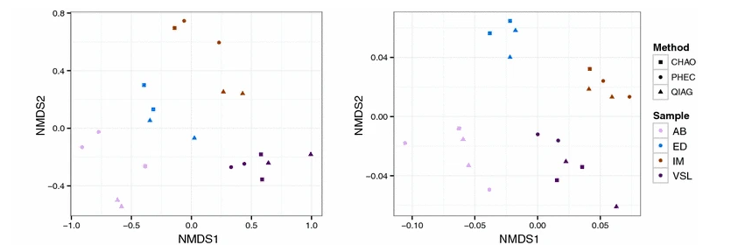
DNA extraction
DNA extraction method also has a significant impact on resulting microbial composition.
Gram positive bacteria can be difficult to lyse – recommended to use mechanical lysis method in DNA extraction.
Low biomass/high host DNA samples present additional challenges
Gerasimidis et al 2016, BMC Research Notes

Slide 9
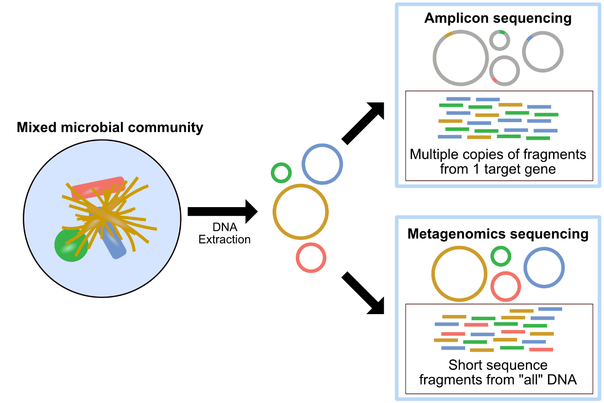
Profiling method - 16S vs Shotgun metagenomics
16S rRNA sequencing
Targeted PCR amplification and sequencing of the 16S ribosomal RNA gene
Useful for discerning community level changes in structure or composition and generating hypotheses.
Not useful for determining abundance of organisms in sample or looking at function.
Shotgun metagenomics
Amplification and sequencing of all DNA in a sample.
Useful for species/strain level identification, functional potential, better at measuring abundances (relative).
Not useful for: true abundance, active function i.e. What genes are being actively transcribed

Slide 10
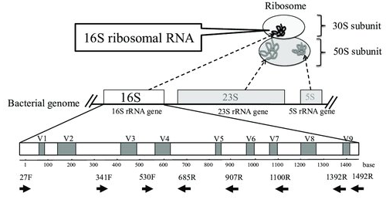
16S rRNA Sequencing - Principal
Small ribosomal subunit
Composed of conserved and hypervariables (V) regions
Can be exploited be identify bacteria (and in some cases archaea)
Relatively inexpensive
Short amplicon sequences ~150-500bp matched against database of full-length sequences to identify bacteria
Usually limited to family/genus level classification

Slide 11
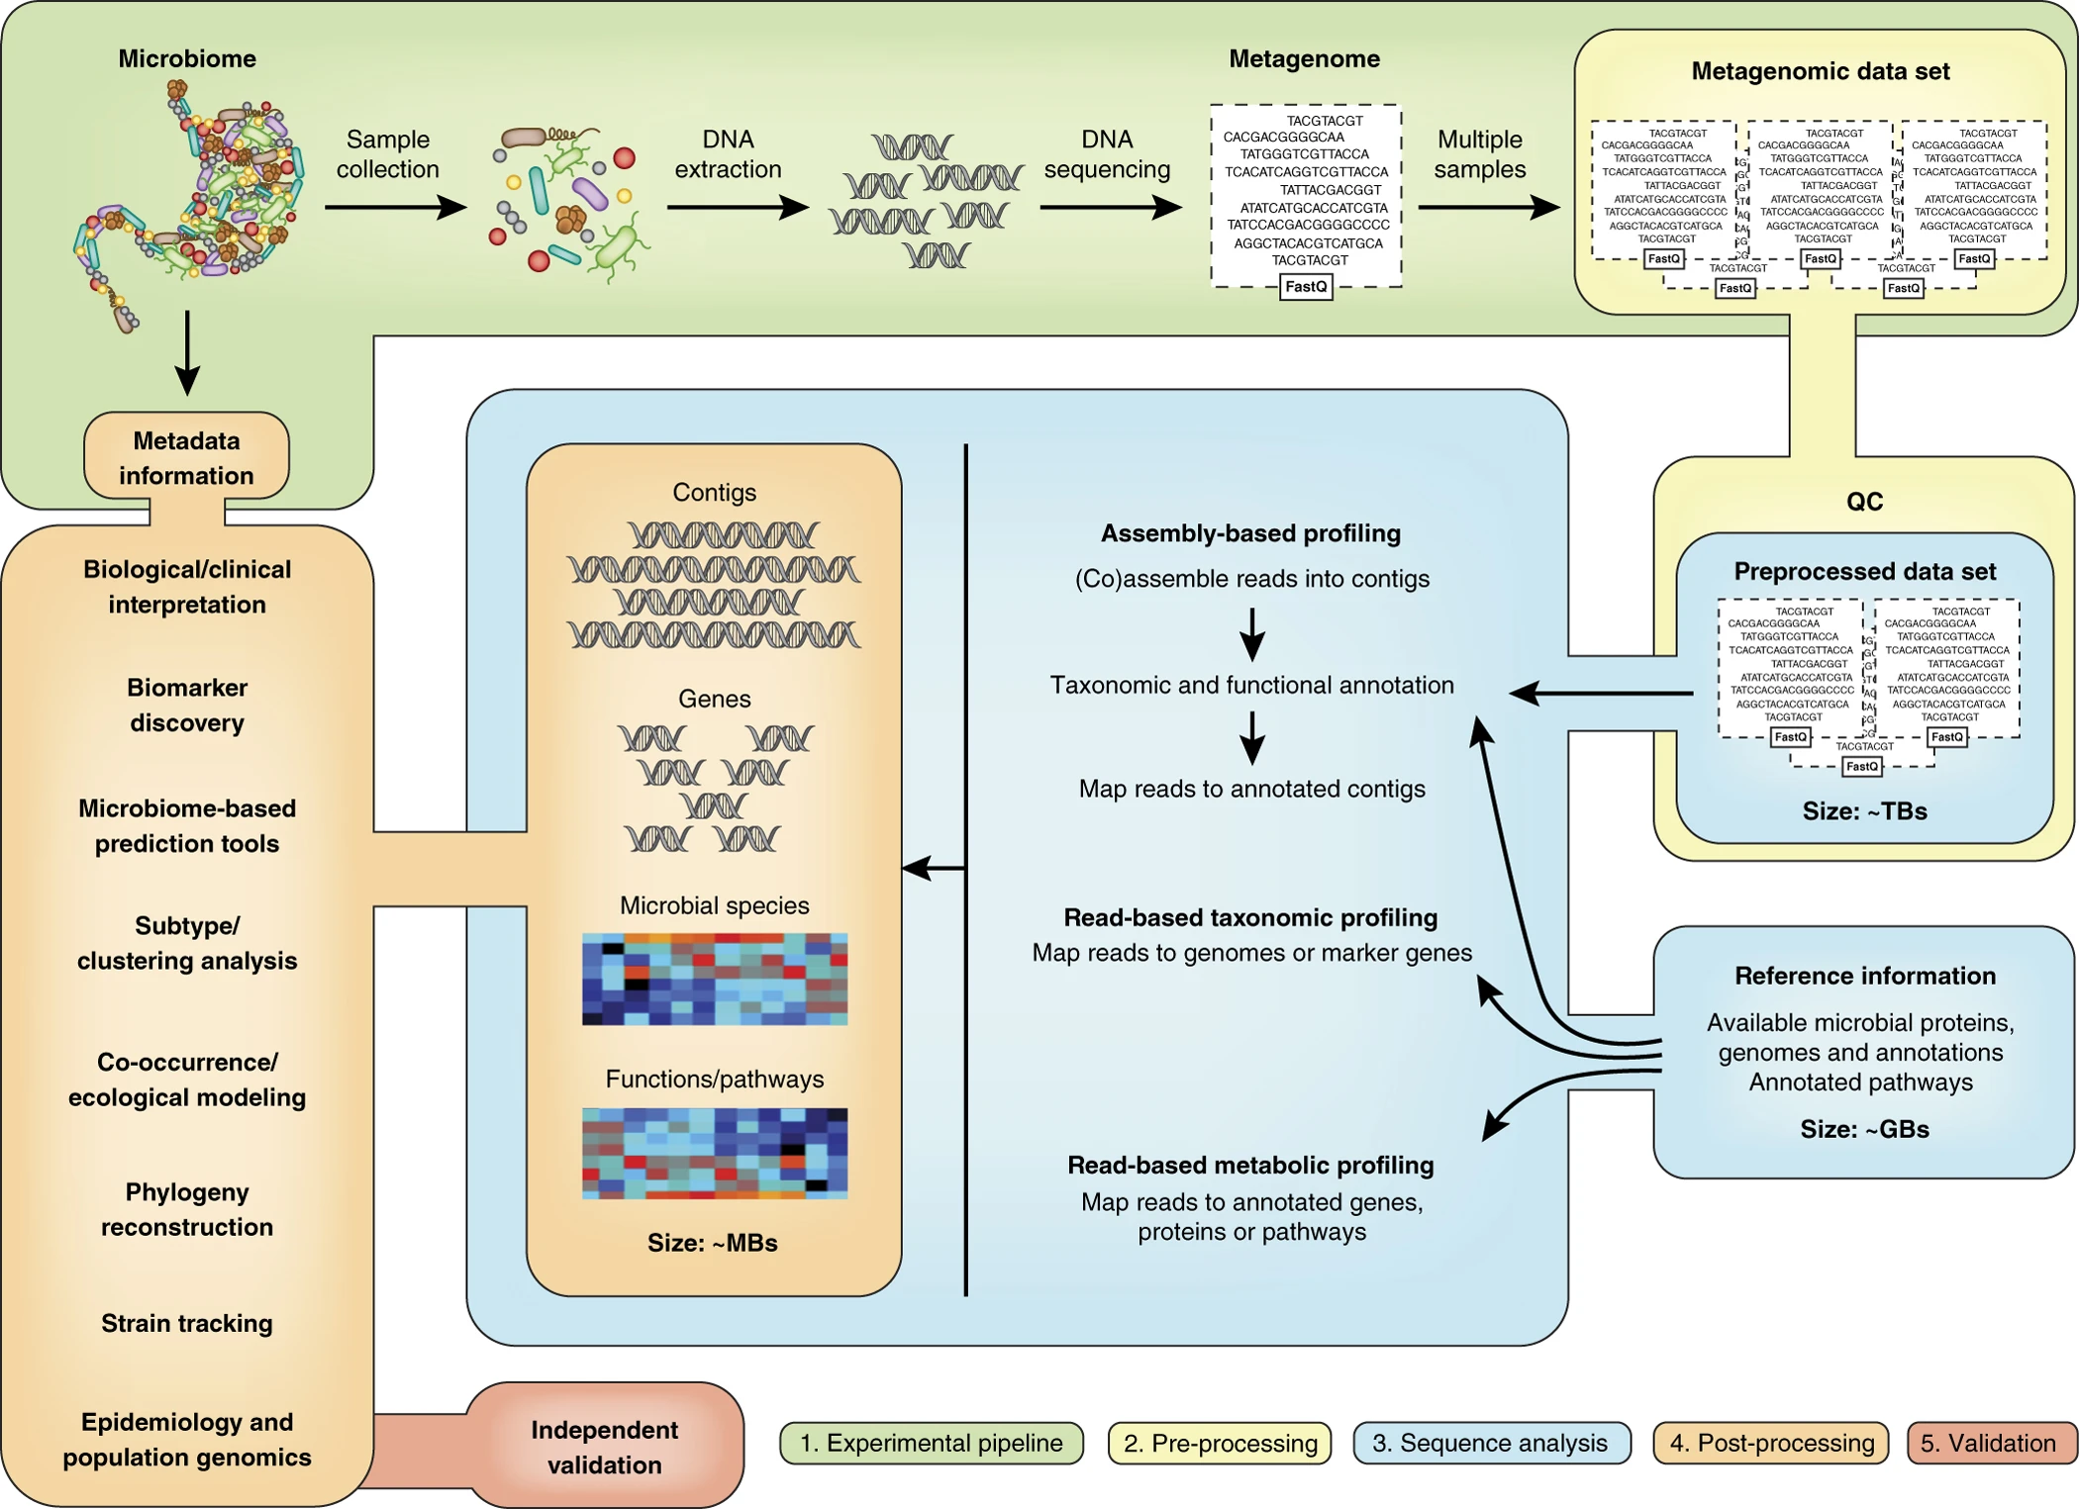
Shotgun Metagenomics
Sequencing of all DNA (regardless of source) in sample using random primers.
Enables higher-resolution analysis
Not limited to bacteria – viruses, fungi, archaea, protists
Strain resolution
Gene content
Read-based or assembly-based
Can still be prohibitively expensive
Particularly for large sample sizes/deep sequencing
Quince et al 2017, Nature Biotechnology

Slide 12
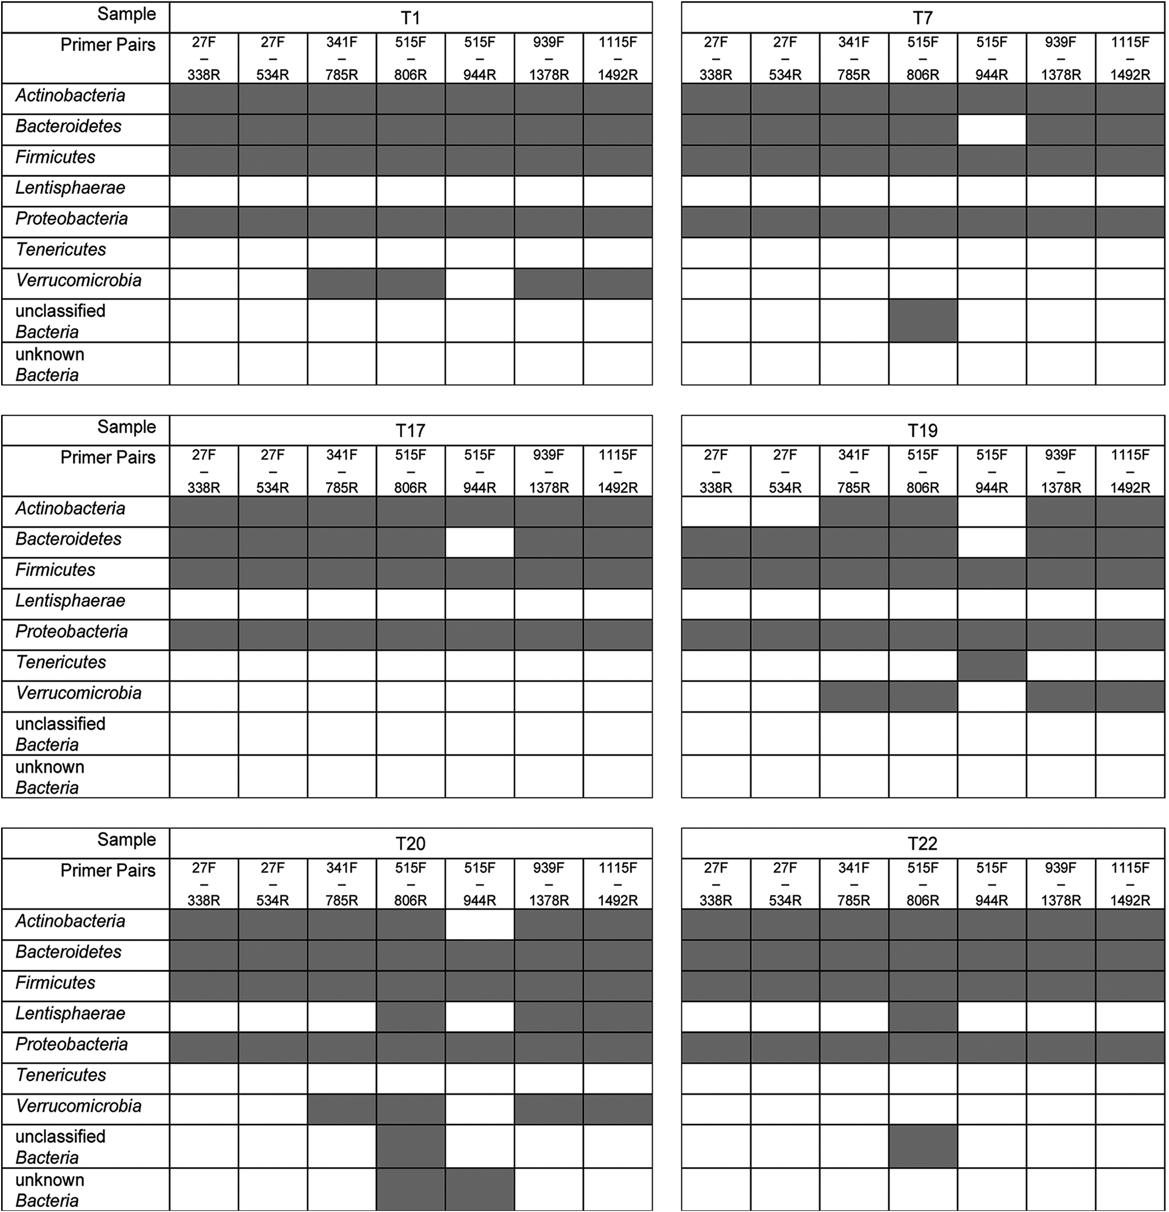
Library preparation and sequencing
Primer/V region choice has a massive impact on resulting microbial community
Number of cycles used during PCR also impact composition/presence of artifacts
HiSeq and MiSeq most commonly used for 16S studies, HiSeq/Nextseq commly used in metagenomics
Abellan-Schneyder et al 2021, mSphere

Slide 13
Outline
1.
Microbiome sample preparation
2.
Microbiome data processing
3.
Microbiome data analysis

Slide 14
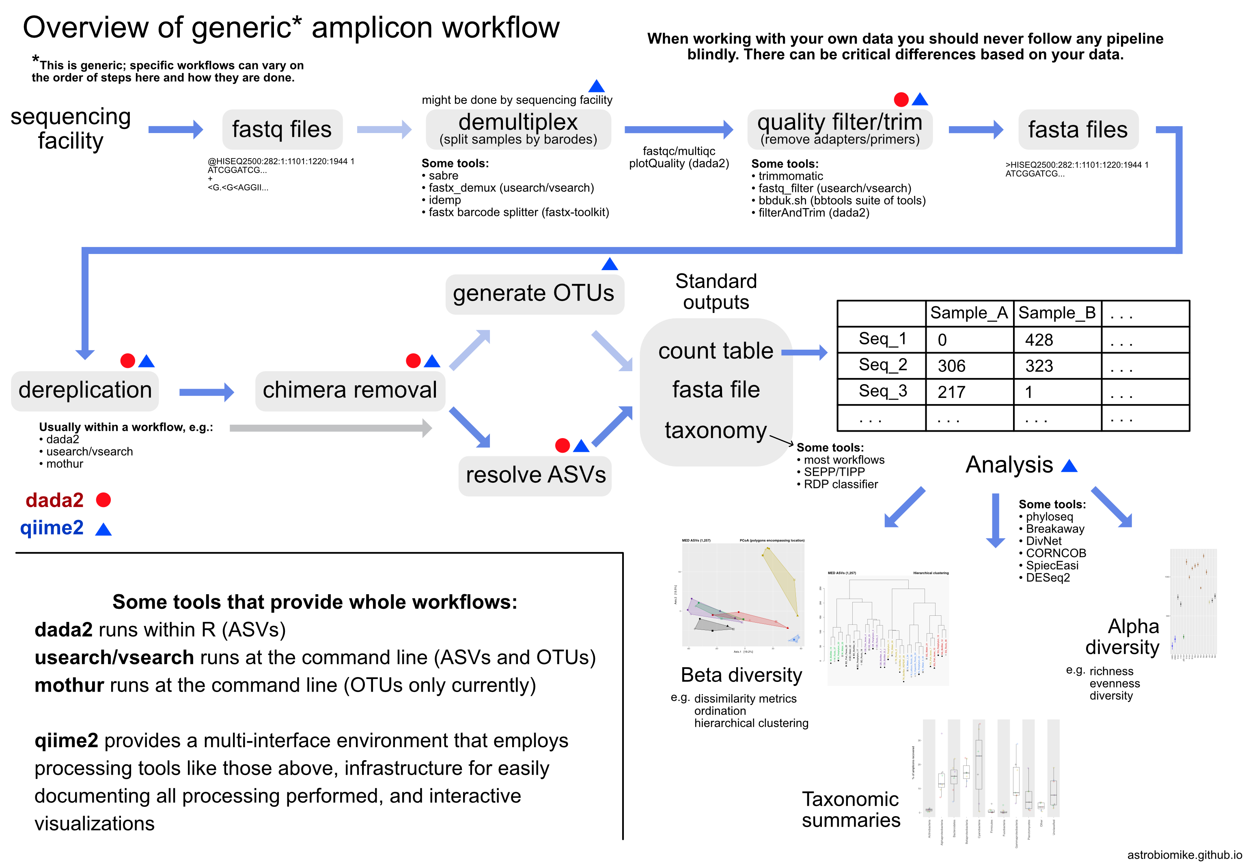
Data processing steps
Like RNAseq raw data is delivered as FASTQ files.
QC
Denoising
Taxonomic assignment/Phylogenetic tree generation
Source: https://astrobiomike.github.io/amplicon/

Slide 15




Choosing software
Many software suites/pipelines to choose from
Qiime2, DADA2, USEARCH, mothur
Choice of software depends on user preference
Widely-used, well-maintained, extensive documentation – good criteria for choosing a particular tool

Slide 16
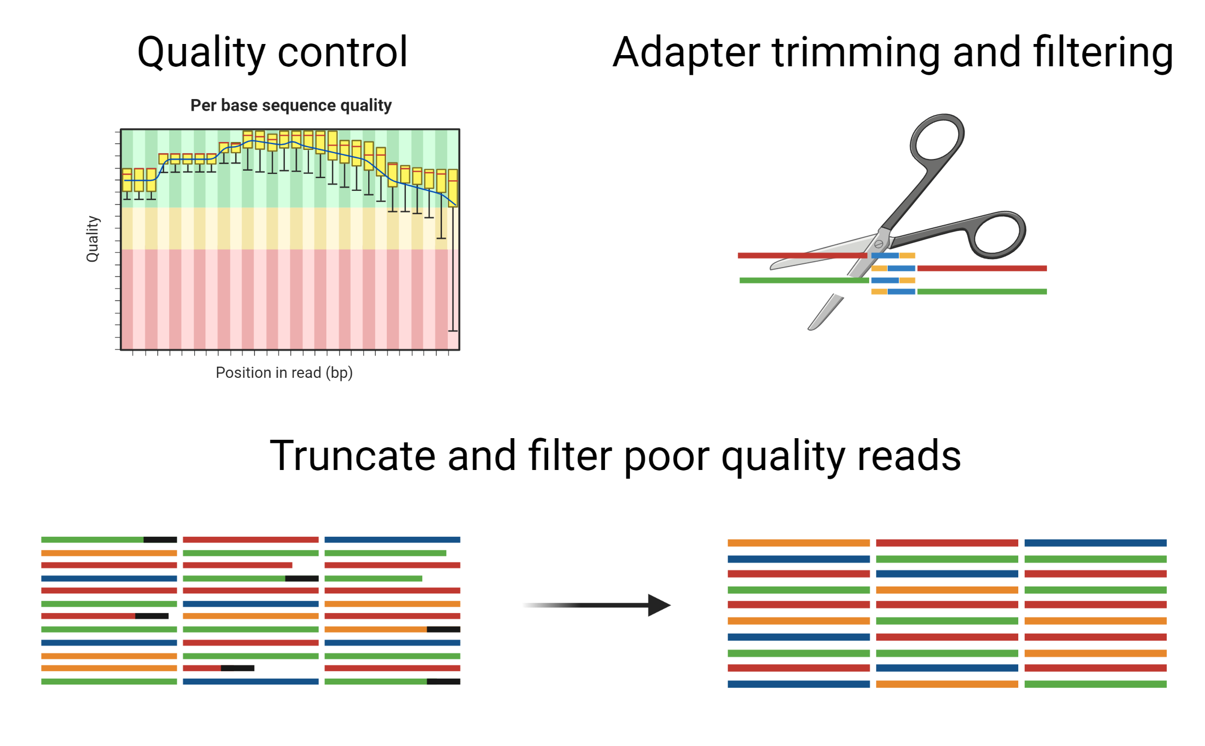
QC
Adapter/primer trimming
Truncate and filter low quality reads
Non-biological sequences/low quality bases interfere with taxonomic assignment.

Slide 17
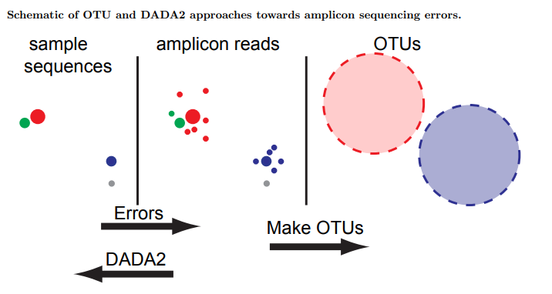
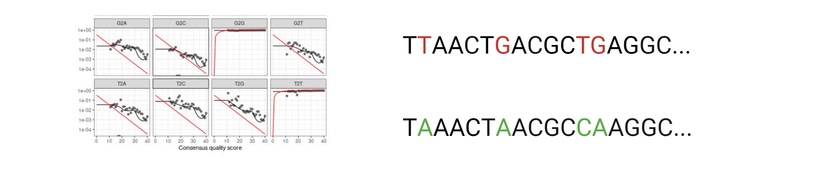
Denoising reads
Improves upon previous method of OTU clustering.
Sequences binned at 97% sequence identity.
Broadly speaking, most methods generate statistical models of error profiles, to identify and remove errors.
Generates real biological sequences, at single nucleotide resolution.

Slide 18
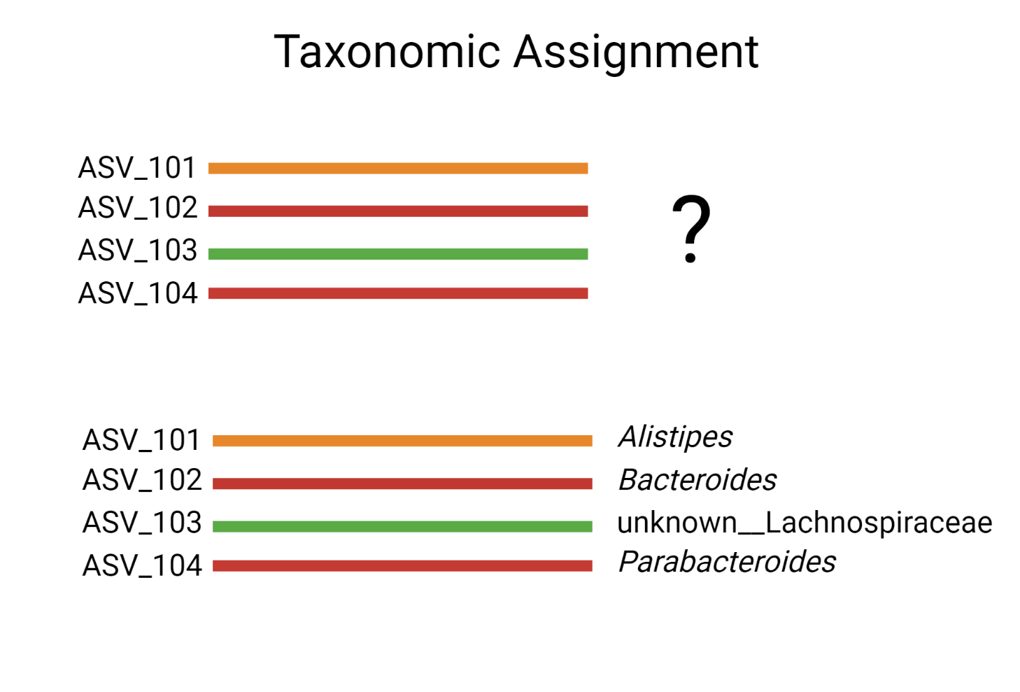
Taxonomic classification
Post-denoising, ASVs assigned taxonomic classification to identify source of sequence
Widely used methods use ML models trained on curated full-length sequence database to classify unknowns.
Databases – SILVA, RDP, Greengenes2
Methods – DECIPHER, RDP-classifier, qiime2 feature-classifier
Resolution depends on length and database used
Assignments differ between databases
Some environments better represented than others

Slide 19
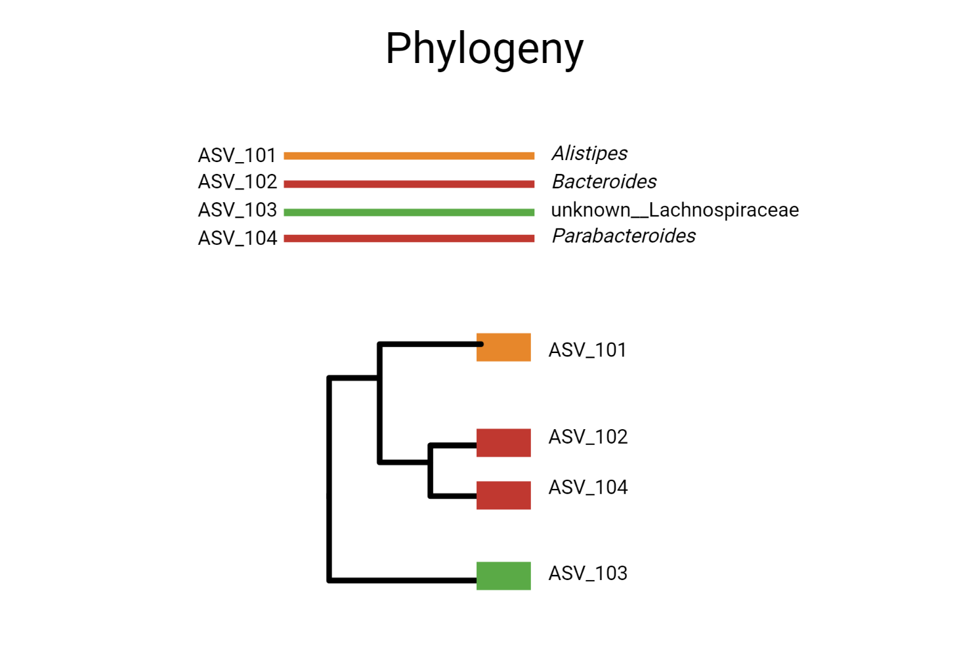
Phylogenetic tree generation
Reconstruction of evolutionary history/robust summary of related biological sequences
Certain analysis methods require information on genetic relatedness between sequences/ASVs.
Sequences are first aligned, then tree calculated using evolutionary model.
Alignment tools – Muscle, MAFFT, ClustalW
Tree tools – FastTree, RAxMl, MrBayes

Slide 20
Outline
1.
Microbiome sample preparation
2.
Microbiome data processing
3.
Microbiome data analysis

Slide 21
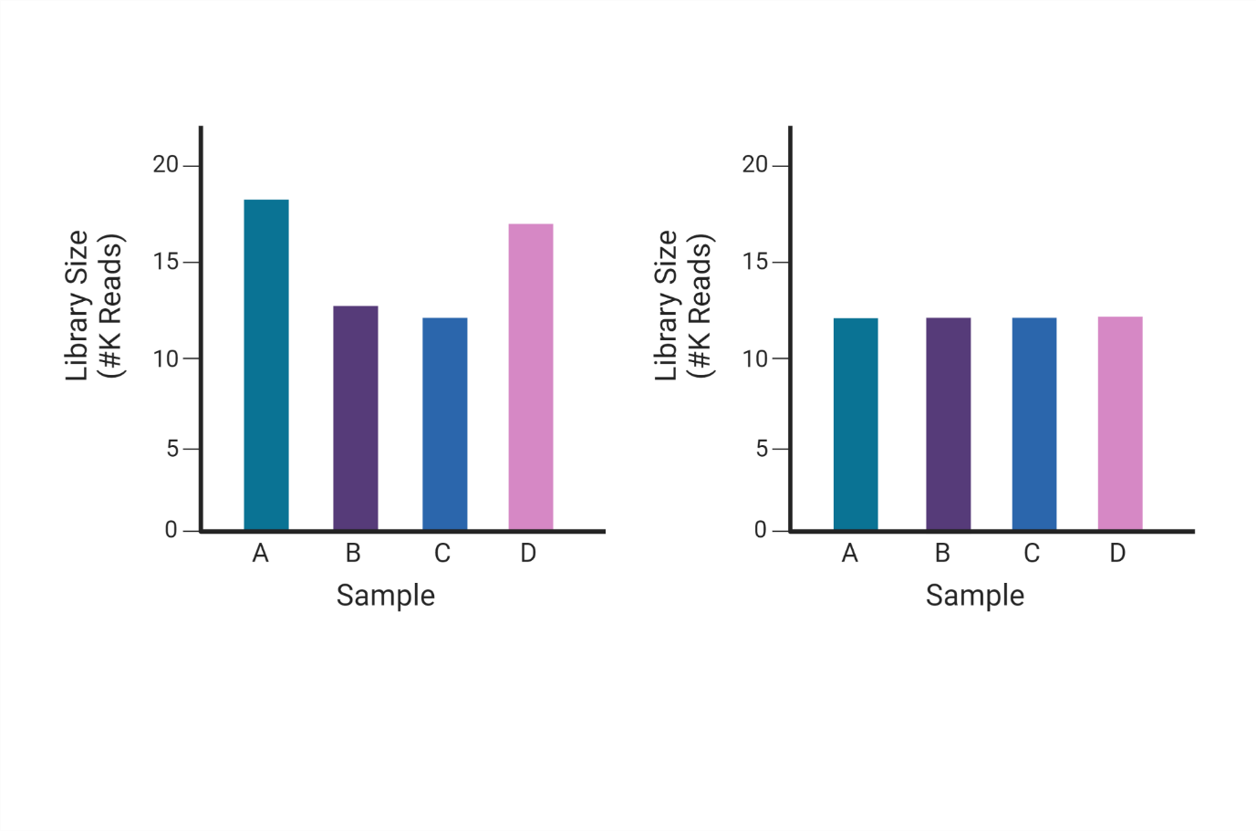
Normalisation – data transformations
Biological and technical variation lead to different library sizes between samples.
Must be controlled for to limit erroneous conclusions
Most commonly used methods are rarefaction or relative abundance.
Rarefaction discards data and not always recommended.
Other methods include minimum sum scaling (MSS).
Scaling of counts to a common factor e.g. lowest sum
Many publications (though not all) now maintain that microbiome data is compositional
Relative information, summing to a constant e.g., 1 or 100
This has implications for how we normalise and analyse our data.
Log-ratio transforms (commonly CLR) used for normalisation
Before normalisation
After normalisation

Slide 22
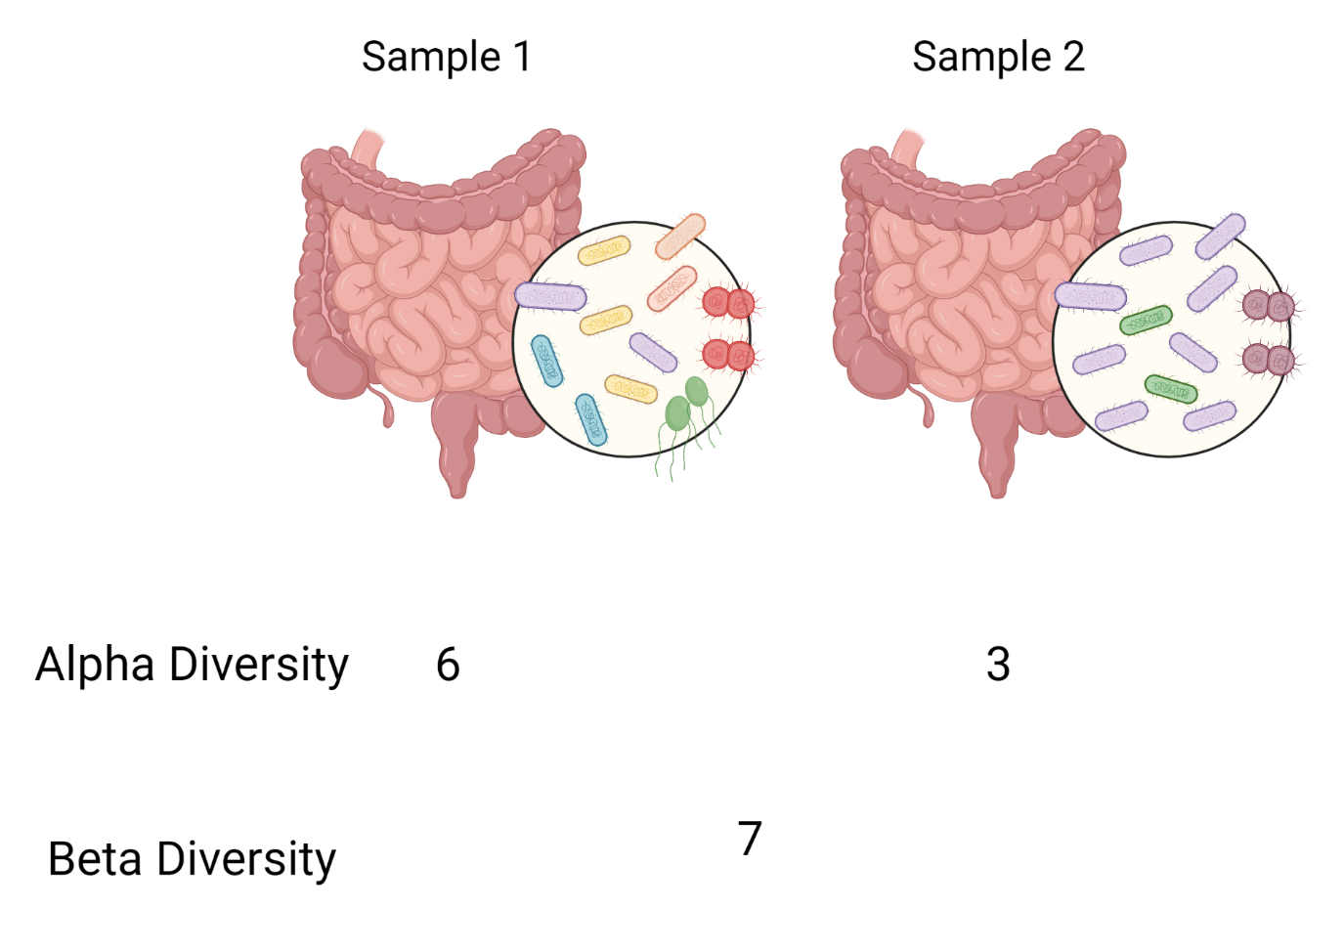
Diversity metrics
Community level
Alpha diversity – within sample, how many different species are present?
Beta-diversity – between samples, how does the composition of species differ among samples?

Slide 23
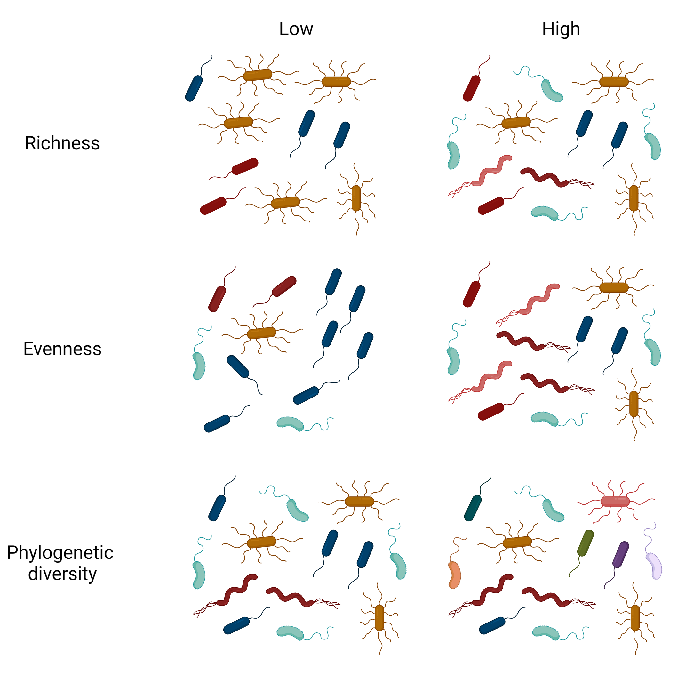
Alpha diversity
Observed species
E.g. Richness, Chao1
Species evenness
E.g. Simpson or Shannon index
Phylogenetic diversity
E.g. Faith’s PD

Slide 24
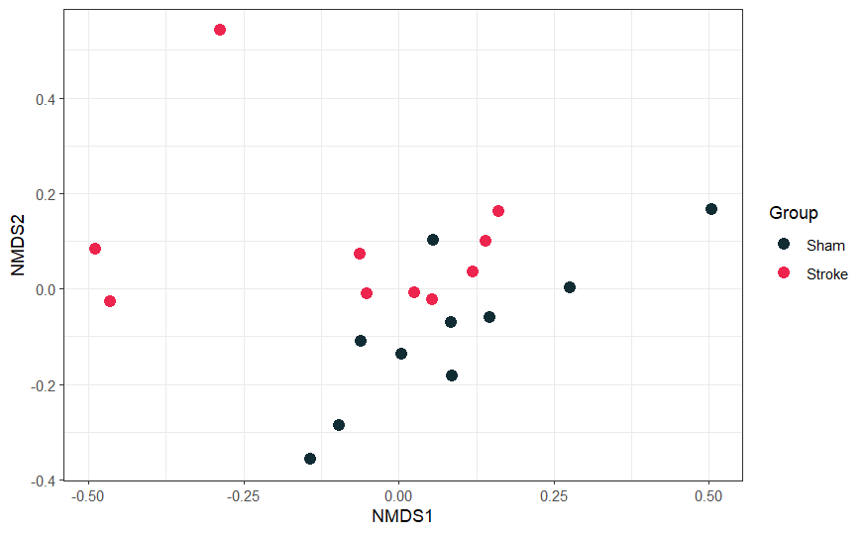
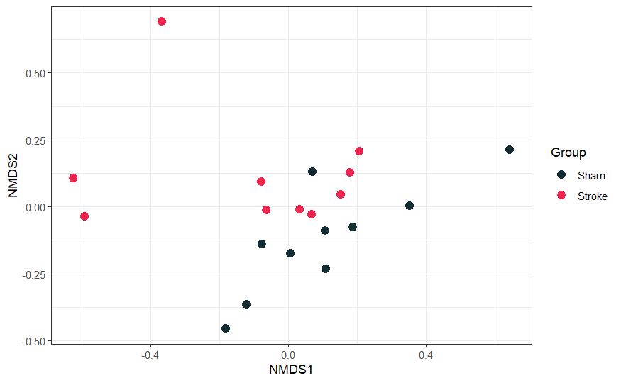
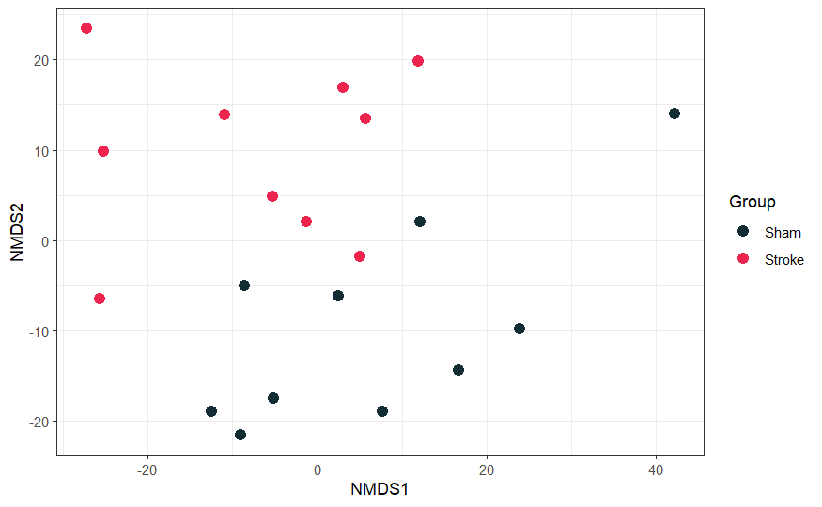
Beta-diversity – non-phylogenetic metrics
Only take species identity and abundance into account.
Bray-curtis, Jaccard
Bray-curtis – quantitative, considers abundance and presence/absence
Jaccard – qualitative, only considers presence/absence
Compositional metrics, include Aitchison distance.
Bray-curtis
Jaccard
Aitchison

Slide 25
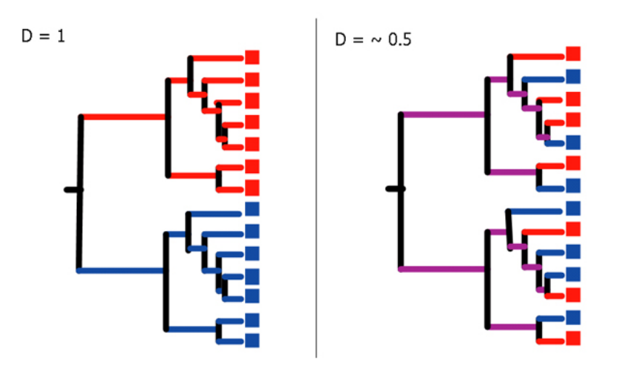
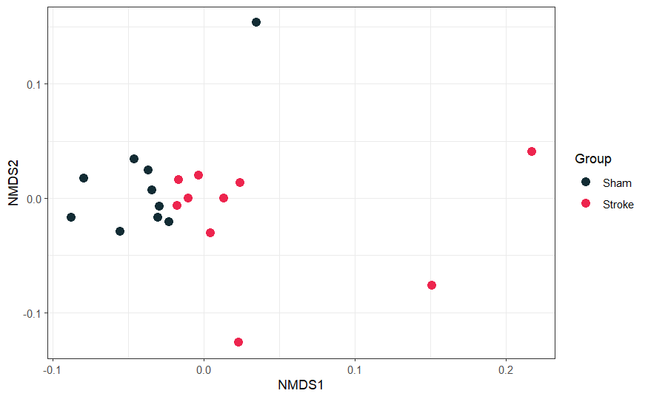
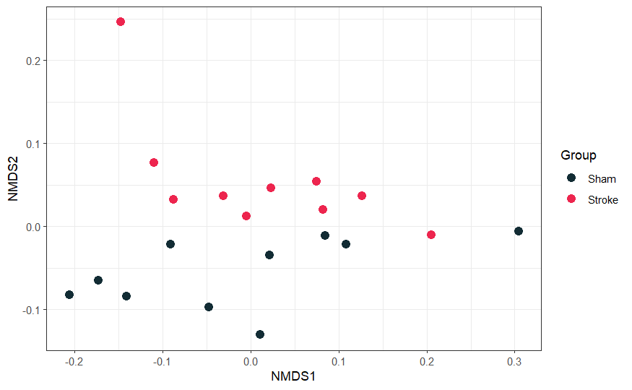
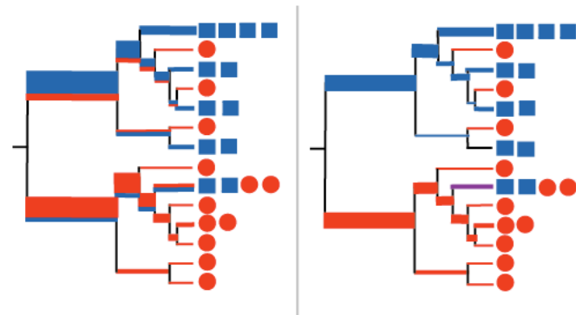
Beta-diversity –phylogenetic metrics
Take genetic relatedness between species (ASVs) into account.
Unweighted UniFrac, weighted UniFrac and generalized UniFrac.
UniFrac
Weighed UniFrac

Slide 26
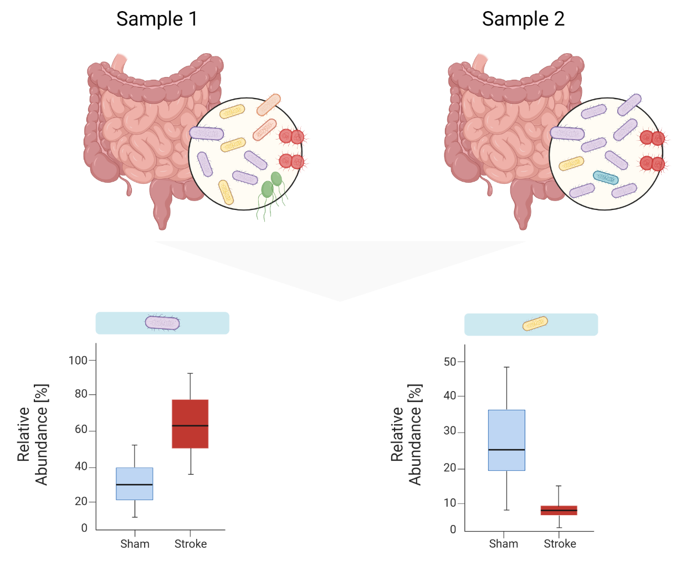
Differential Abundance
Which individual species differ between samples?
In this example, the purple species is enriched in stroke and yellow species is depleted.

Slide 27
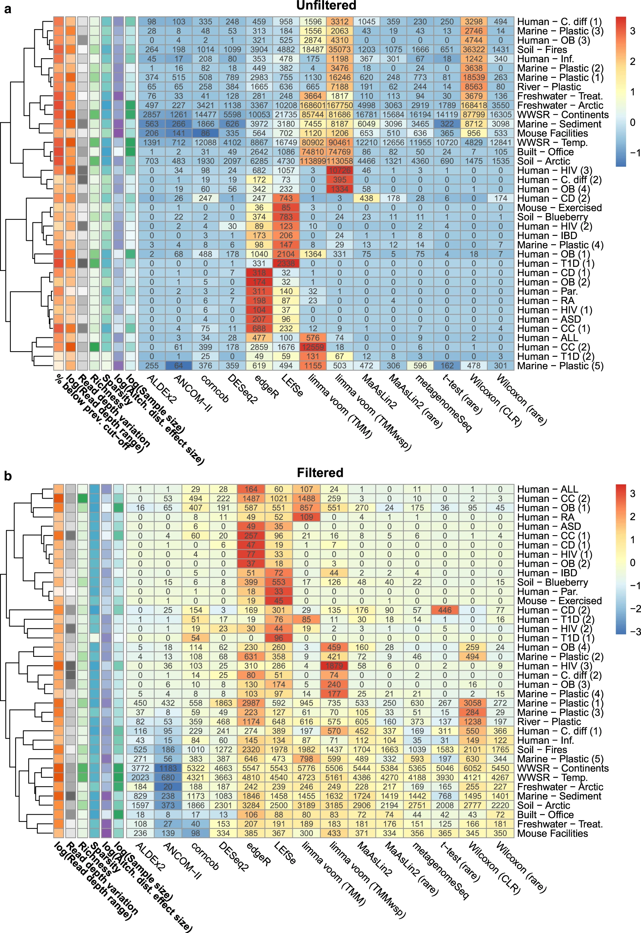
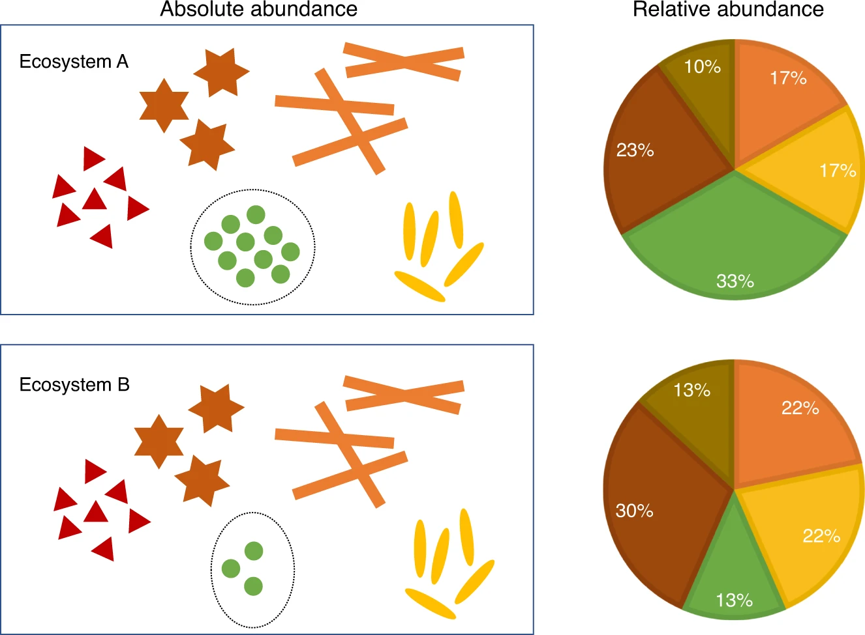
Differential abundance methods
Can be broadly split into compositional and non-compositional metrics.
Significant variation in both number and identity of identified DA ASVs between pipelines
Several compositional methods offer “best” accuracy
Reduced number of FP
ALDEx2, ANCOM2/ANCOM-BC2
Nearing et al 2022, Nature Communications

Slide 28
Any questions?

